Slide 1
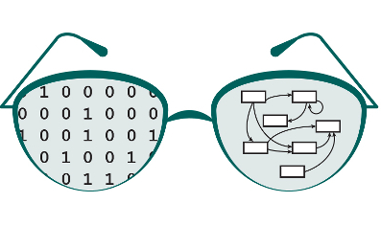


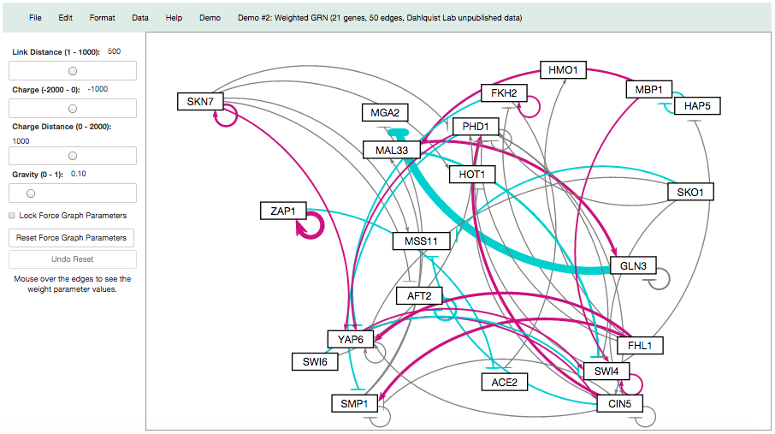
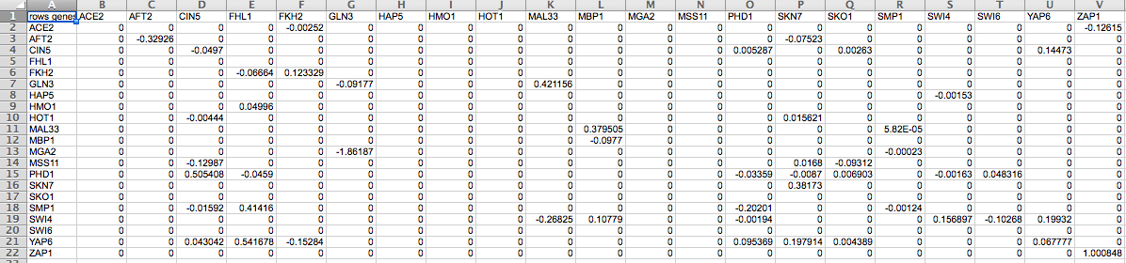

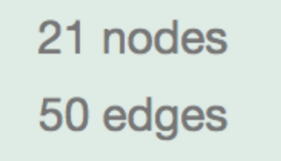
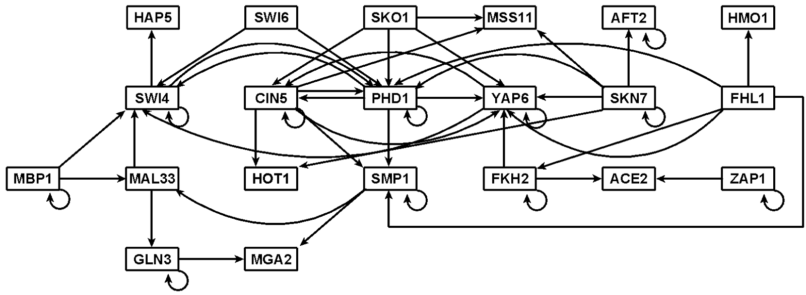

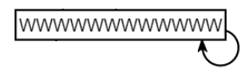
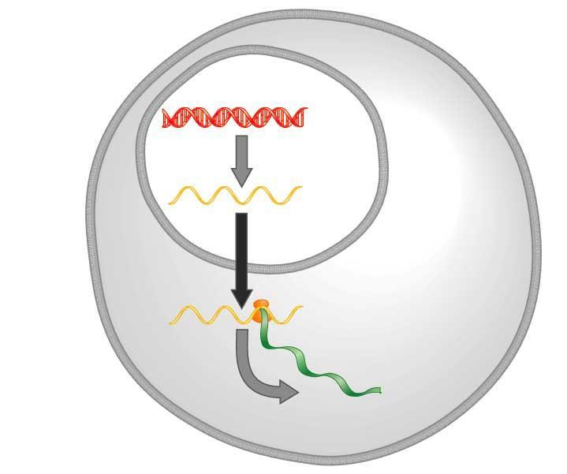
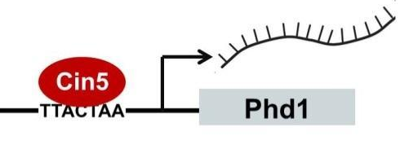
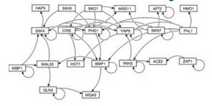
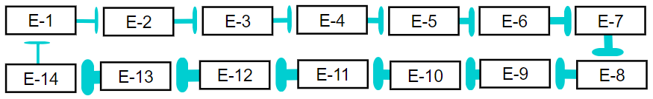
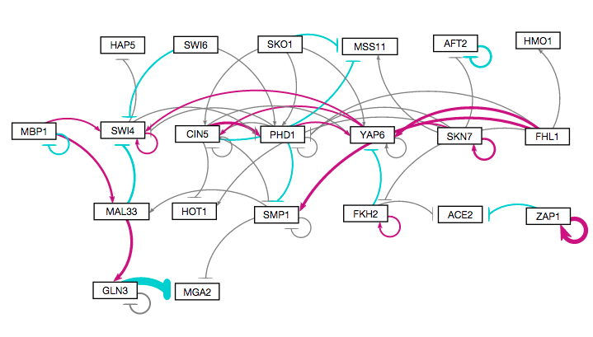
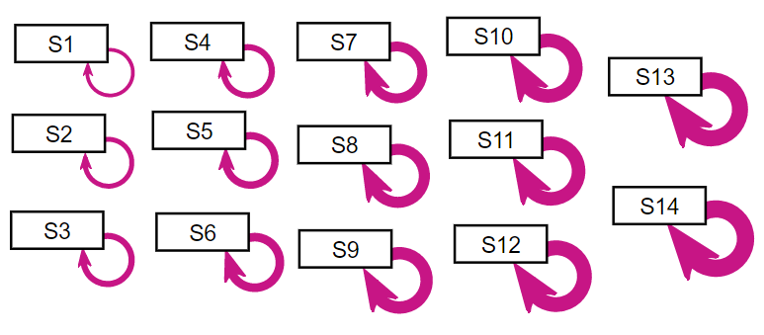
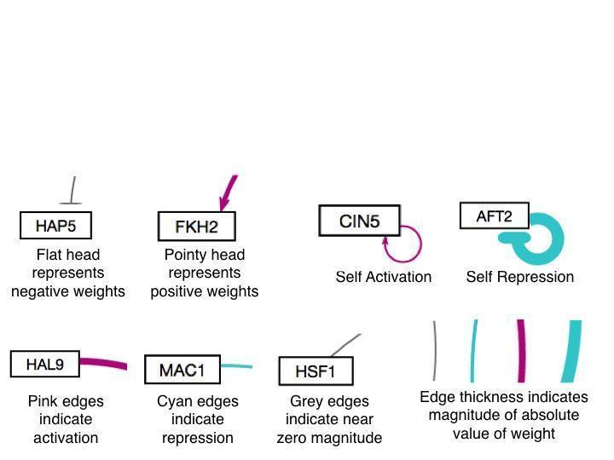
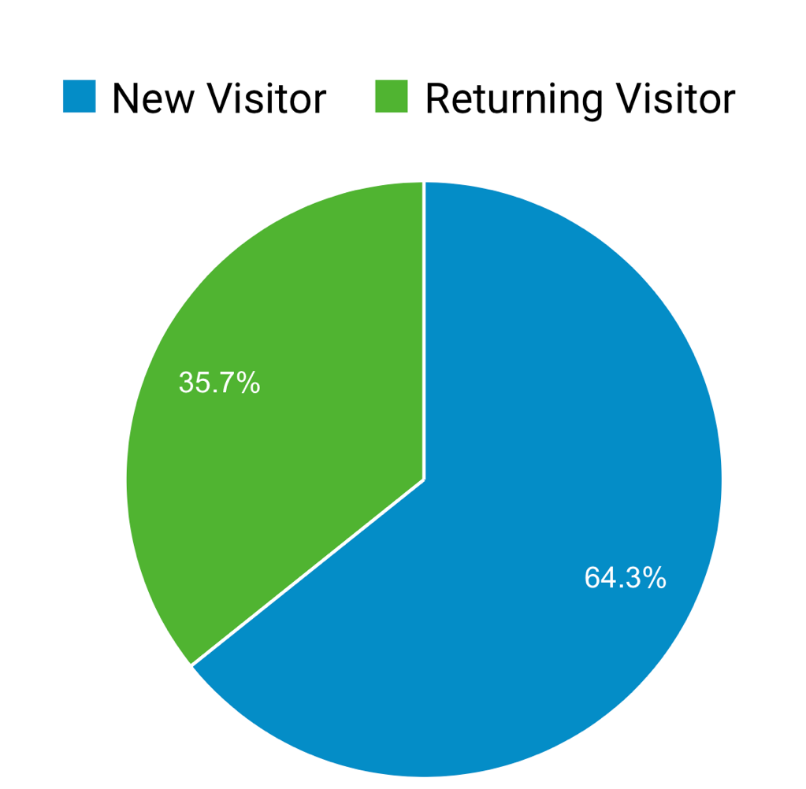
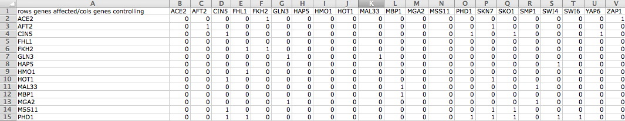
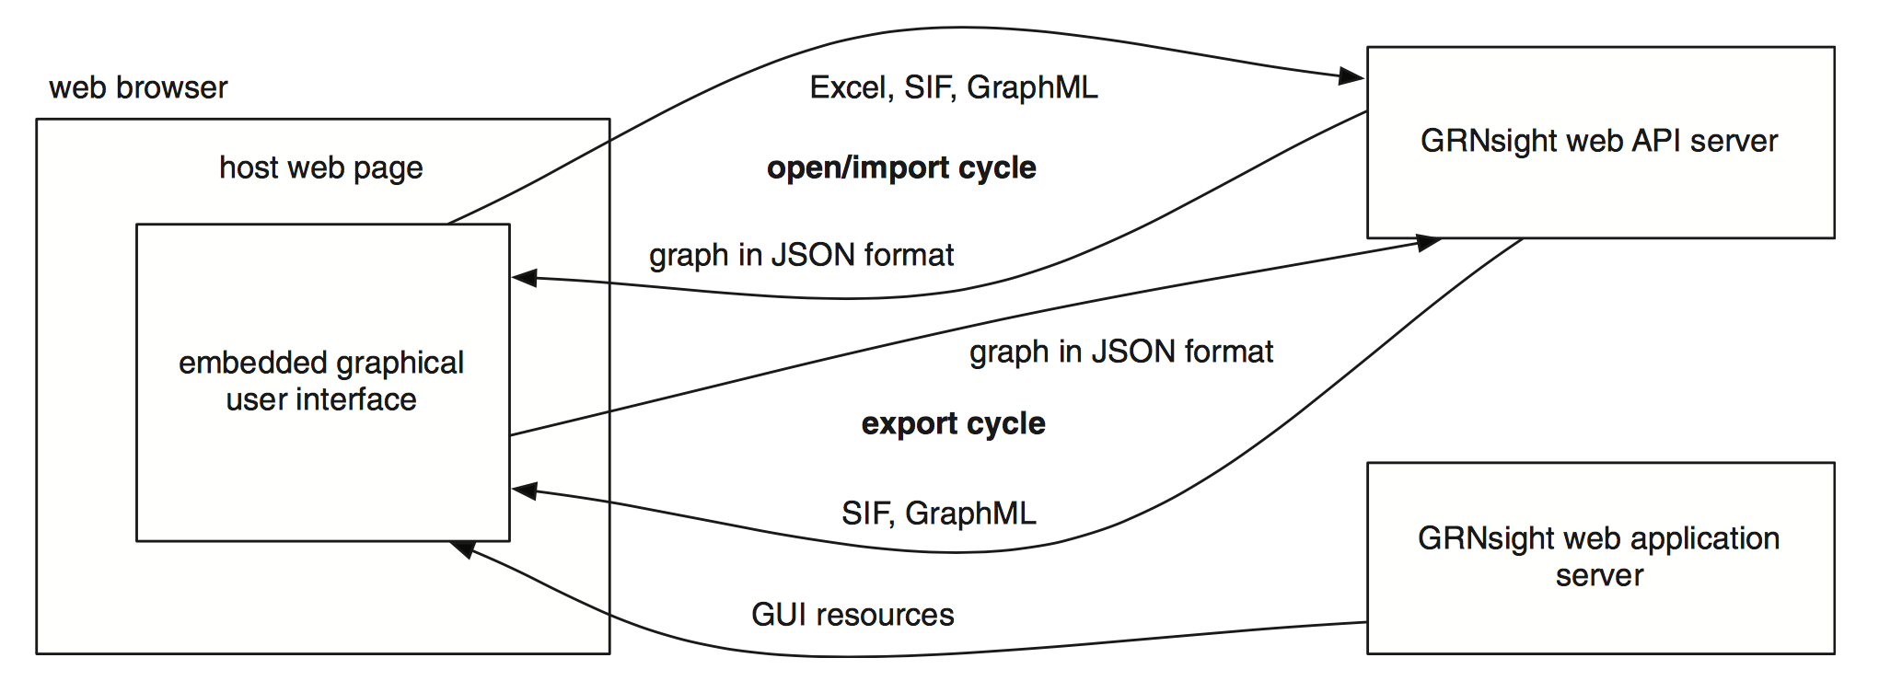
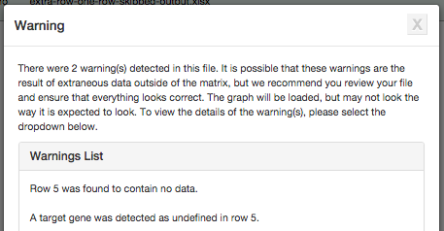
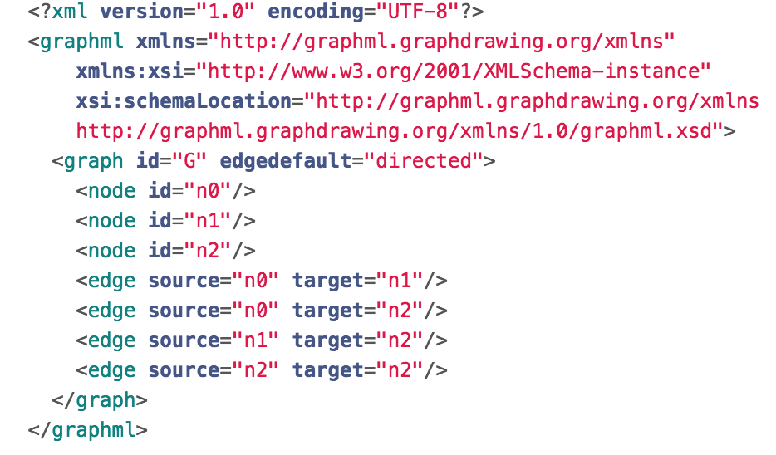
Improved Visual Performance and Enhanced Test Files for Different File Formats for
GRNsight: a Web Application for Visualizing Models of Gene Regulatory Networks
Yeon-Soo Shin**, Edward Bachoura**, Eileen Choe**, John David N. Dionisio**, Kam D. Dahlquist*
*Department of Biology, **Department of Electrical Engineering and Computer Science, Loyola Marymount University, 1 LMU Drive, Los Angeles, CA 90045
http://dondi.github.io/GRNsight/
Gene Regulatory Networks (GRNs) Can Be Illustrated by Directed Graphs
GRNsight Automatically Lays Out Unweighted and Weighted Network Graphs
Improved Visual Performance
The central dogma of molecular biology describes how the flow of information in a cell during gene expression goes from DNA to RNA to protein.
Transcription factors control gene expression by binding to regulatory DNA sequences.
Activators increase gene expression.
Repressors decrease gene expression.
Transcription factors are themselves proteins encoded by genes.
Freeman (2002)
A gene regulatory network (GRN) consists of genes, transcription factors, and the regulatory connections between them, which govern the level of expression of mRNA and proteins from those genes.
Each node in a GRN graph represents the gene, mRNA, and protein expressed from the gene; each edge represents a regulatory relationship.
All the nodes are transcription factors themselves.
1
4
Unweighted graph drawn manually with Adobe Illustrator
GRNsight Beta displays enhanced visual performance
Excel Spreadsheet
3. Weighted graph laid out automatically
Node adjustments
Long node labels with unpleasing self-regulatory arrows are now adjusted to start from the end of the node regardless of the length of the node and the thickness of the edge.
1. Menu Bar
Four demo files can be found in the “Demo” menu for users who do not have their own data.
Print functionality is accessed from the “File” menu option.
“File > Reload” reloads the current graph with the active settings.
In the “Edit > Preferences” menu, the user can select for weighted graphs to be displayed as unweighted graphs.
2
Produced in several hours
Blunt Marker Adjustments
The repressed markers are centered. The edges now display equivalent spacing for when the target node is to the right from the source node and when it is to the left.
DNA
Unweighted graph laid out automatically by GRNsight and adjusted by hand
The repressed markers are centered.
RNA
Protein
2. Force Graph Parameter Sliders
Link distance determines the minimum distance between nodes.
Nodes have a charge, which repels or attracts other nodes.
The charge distance determines at what range a node’s charge will affect other nodes.
Gravity determines the strength of the force holding the nodes to the center of the graph.
Reset functionality sets all parameters to default settings.
Locking the parameters prevents any further changes.
Produced in ~10 milliseconds
Produced in ~5 minutes
Arrowhead Adjustments
The arrowheads are centered on the edge and the tips are hidden underneath the node, especially compared to the previous version
3. Nodes, Edges, and Arrows
The absolute values of each weight parameter are normalized to a value between 0 and 1. The thicknesses of the lines are adjusted to vary continuously from the minimum thickness (for normalized weights near zero) to the maximum thickness (normalized weights of 1).
Edges with negative weights (repression) are colored cyan with blunt end markers; edges with positive weights (activation) are colored magenta with pointed arrowheads; edges with normalized weight values between -0.05 and 0.05 are colored grey to signify a weak influence on the target gene.
Weighted graph laid out automatically by GRNsight and adjusted by hand
Each visual adjustments were carefully tested with according test files.
GRNsight Fulfills a Specific Software Niche for Visualizing Small- to Medium-scale GRNs
Although other open source software, such as Cytoscape or Gephi, exists to lay out large networks, they were too cumbersome for our needs.
GRNsight is targeted at both experienced biology investigators and novice undergraduate users and has the following requirements:
Exist as a web application.
Be simple and intuitive to use.
3. Accept Excel (.xlsx) files directly from our sister project, GRNmap, as well as, SIF (.sif), or GraphML (.graphml) input files.
Read a weighted or unweighted adjacency matrix.
Automatically lay out and display unweighted and weighted, directed network graphs.
Produced in ~5 minutes
4. Status Bar
The name of the uploaded file is displayed.
The number of nodes and edges of the graph are displayed in the far right hand side.
Future Directions
GRNsight Has Sophisticated Architecture and Follows
Open Source Development Practices
Unit Testing Framework Was Optimized
Further expand and refine the unit testing framework.
Allow users to choose different layout options to view the graph.
Add node coloring for gene expression temporal data.
Clicking a node will take the user to the according gene page.
Converting D3 v3 to v4 and Javascript from ES5 to ES6
GRNsight Accepts Microsoft Excel, SIF, and GraphML Files in the Proper Format
GRNsight has a service-oriented architecture
GRNsight has two pieces: a server and a web client.
The server uses the node.js framework to receive and parse the Excel spreadsheet, SIF, or GraphML file uploaded by the user.
The web client receives the data from the server and generates the graph visualization.
Mocha and Chai JavaScript testing framework
The unit testing framework consists of 216 passing tests covering over
500 test files.
The addition of SIF and GraphML file format options besides the existing Excel imports, required re-organization of the testing framework.
Testing is now split into two different test groups, with semantic tests being file-format independent, and individualized syntactic tests being based on the different file formats.
Errors found in the semantic checker test are generally considered fatal, whereas most of the syntactic checker tests return warnings and still display the graph.
Availability
Excel
Excel workbooks need a “network” sheet (for unweighted graphs) or a “network_optimized_weights” sheet (for weighted graphs). The adjacency matrix can be symmetrical or asymmetrical.
GRNmap input and output workbooks are accepted without adjustment.
Adjacency matrices generated from other databases, such as YEASTRACT (Teixeira et al., 2014), can be used with some modification.
GRNsight now accepts SIF and GraphML files without any modification
GRNsight is free and open to all users and there is no login requirement.
Web site content is available under the Creative Commons Attribution Non-Commercial Share Alike license.
GRNsight code is available under the open source BSD license.
Usage is being tracked through Google Analytics.
GRNsight has been tested with and confirmed to be working in Chrome version 43 or higher and Firefox version 38 or higher on Windows 7 and Mac OS X.
Import Excel
Excel Syntax Checker
5564 total visitors and
2019 files uploaded as of
26 January 2017
SIF
A SIF file is a tab-delimited text file with the file extension .sif originally created for use with Cytoscape.
Lines in the SIF file specify a source node, a relationship type (or edge type), and one or more target nodes separated by tab characters.
Import SIF
SIF Syntax Checker
Semantic Checker
GRNsight
Import GraphML
GraphML Syntax Checker
Acknowledgments
Error catching was greatly improved
Robustness was greatly extended.
Instead of crashing when given an improperly formatted or incorrect file, GRNsight returns an error in a modal window.
This work is partially supported by NSF award 0921038 (K.D.D., B.G.F.), a Kadner-Pitts Research Grant (K.D.D.), the Loyola Marymount University Rains Research Assistant Program (N.A.A.), and the Loyola Marymount University Summer Undergraduate Research Program (A.V.).
GRNsight implementation takes advantage of other open source tools
GRNsight uses the Data-Driven Documents (D3) JavaScript library to generate a graph derived from input network data.
D3 dynamically manipulates HTML and Scalable Vector Graphics (SVG) to form the elements of the graph.
GRNsight implements D3’s force layout algorithm which applies a physics-based simulation to the graph.
D3 also allows for the fine tuning of Cascading Style Sheets (CSS), the code that styles web pages.
GRNsight follows an open development model using an open source github.com code repository and issue tracking.
GraphML
A GraphML file is an Extensible Markup Language (XML) file with the extension .graphml.
GRNsight parses GraphML to extract nodes and edges.
GraphML has the ability to specify additional graph features that GRNsight cannot display, but may be useful additional data.
Warnings are returned in cases of non-fatal improper spreadsheets
References
In cases where non-fatal errors exist in the format or data of an uploaded spreadsheet, the graph is displayed, and a warning box appears.
Cytoscape: http://cytoscape.org
Dahlquist, K.D., Dionisio, J.D.N., Fitzpatrick, B.G., Anguiano, N.A., Varshneya, A., Southwick, B.J., Samdarshi, M. (2016) GRNsight: a web application and service for visualizing models of small- to medium-scale gene regulatory networks. PeerJ Computer Science 2:e85. DOI: 10.7717/peerj-cs.85).
Dahlquist, K.D., Fitzpatrick, B.G., Camacho, E.T., Entzminger, S.D., and Wanner, N.C. (2015) Parameter Estimation for Gene Regulatory Networks from Microarray Data: Cold Shock Response in Saccharomyces cerevisiae. Bulletin of Mathematical Biology, 77(8), 1457-1492, DOI: 10.1007/s11538-015-0092-6
D3.js: http://d3js.org/
Freeman, S., (2002). Biological science, 1st edition. Upper Saddle River, NJ:: Prentice Hall.
Gephi: https://gephi.org
GRNmap: http://kdahlquist.github.io/GRNmap/
Teixeira, M. C., Monteiro, P. T., Guerreiro, J. F., Gonçalves, J. P., Mira, N. P., dos Santos, S. C., ... & Madeira, S. C. (2014). The YEASTRACT database: an upgraded information system for the analysis of gene and genomic transcription regulation in Saccharomyces cerevisiae. Nucleic Acids Research, 42(D1), D161-D166, DOI: 10.1093/nar/gkt1015
Warnings clearly state which row(s) or cell(s) may have incorrect data.
The warning box can be closed and reopened at any time via a hyperlink underneath Force Graph Parameter sliders.
Notes:
Kill abstract
Change to sans serif font
Make title bigger
Make title background white
Use full names
Super script to associate names with correct department
Background color: make it dark green, make writing on white background and writing in black/dark green
4 columns!!!
Smaller pictures
Bold titles
References can be 12pt
Acknowledgements can be 16pt
Everything else is 18-24pt
Titles don’t need to be bigger than 36pt
Remove circles from the arrowhead diagram, group the related labels together
Include menu bar
Testing/error handling – sample error (we don’t crash with errors!)
Mouseovers for edges screenshot

